Slide 1
7:00–7:15pm
Welcome to Back-to-School Night 1st Block AP Chemistry, A223 Terri Mehalick
Please take an index card and write (1) your name, (2) your student’s name, and (3) at least one thing that you think I should know about your student to help them succeed.
Please reach out to me at any time: tmehalick@cbsd.org
For your reference, tonight’s PowerPoint will be posted on my SchoolWires site: https://www.cbsd.org/tmercer

Slide 2
7:20–7:30pm
Welcome to Back-to-School Night 2nd Block AP Chemistry, A223 Terri Mehalick
Please take an index card and write (1) your name, (2) your student’s name, and (3) at least one thing that you think I should know about your student to help them succeed.
Please reach out to me at any time: tmehalick@cbsd.org
For your reference, tonight’s PowerPoint will be posted on my SchoolWires site: https://www.cbsd.org/tmercer

Slide 3
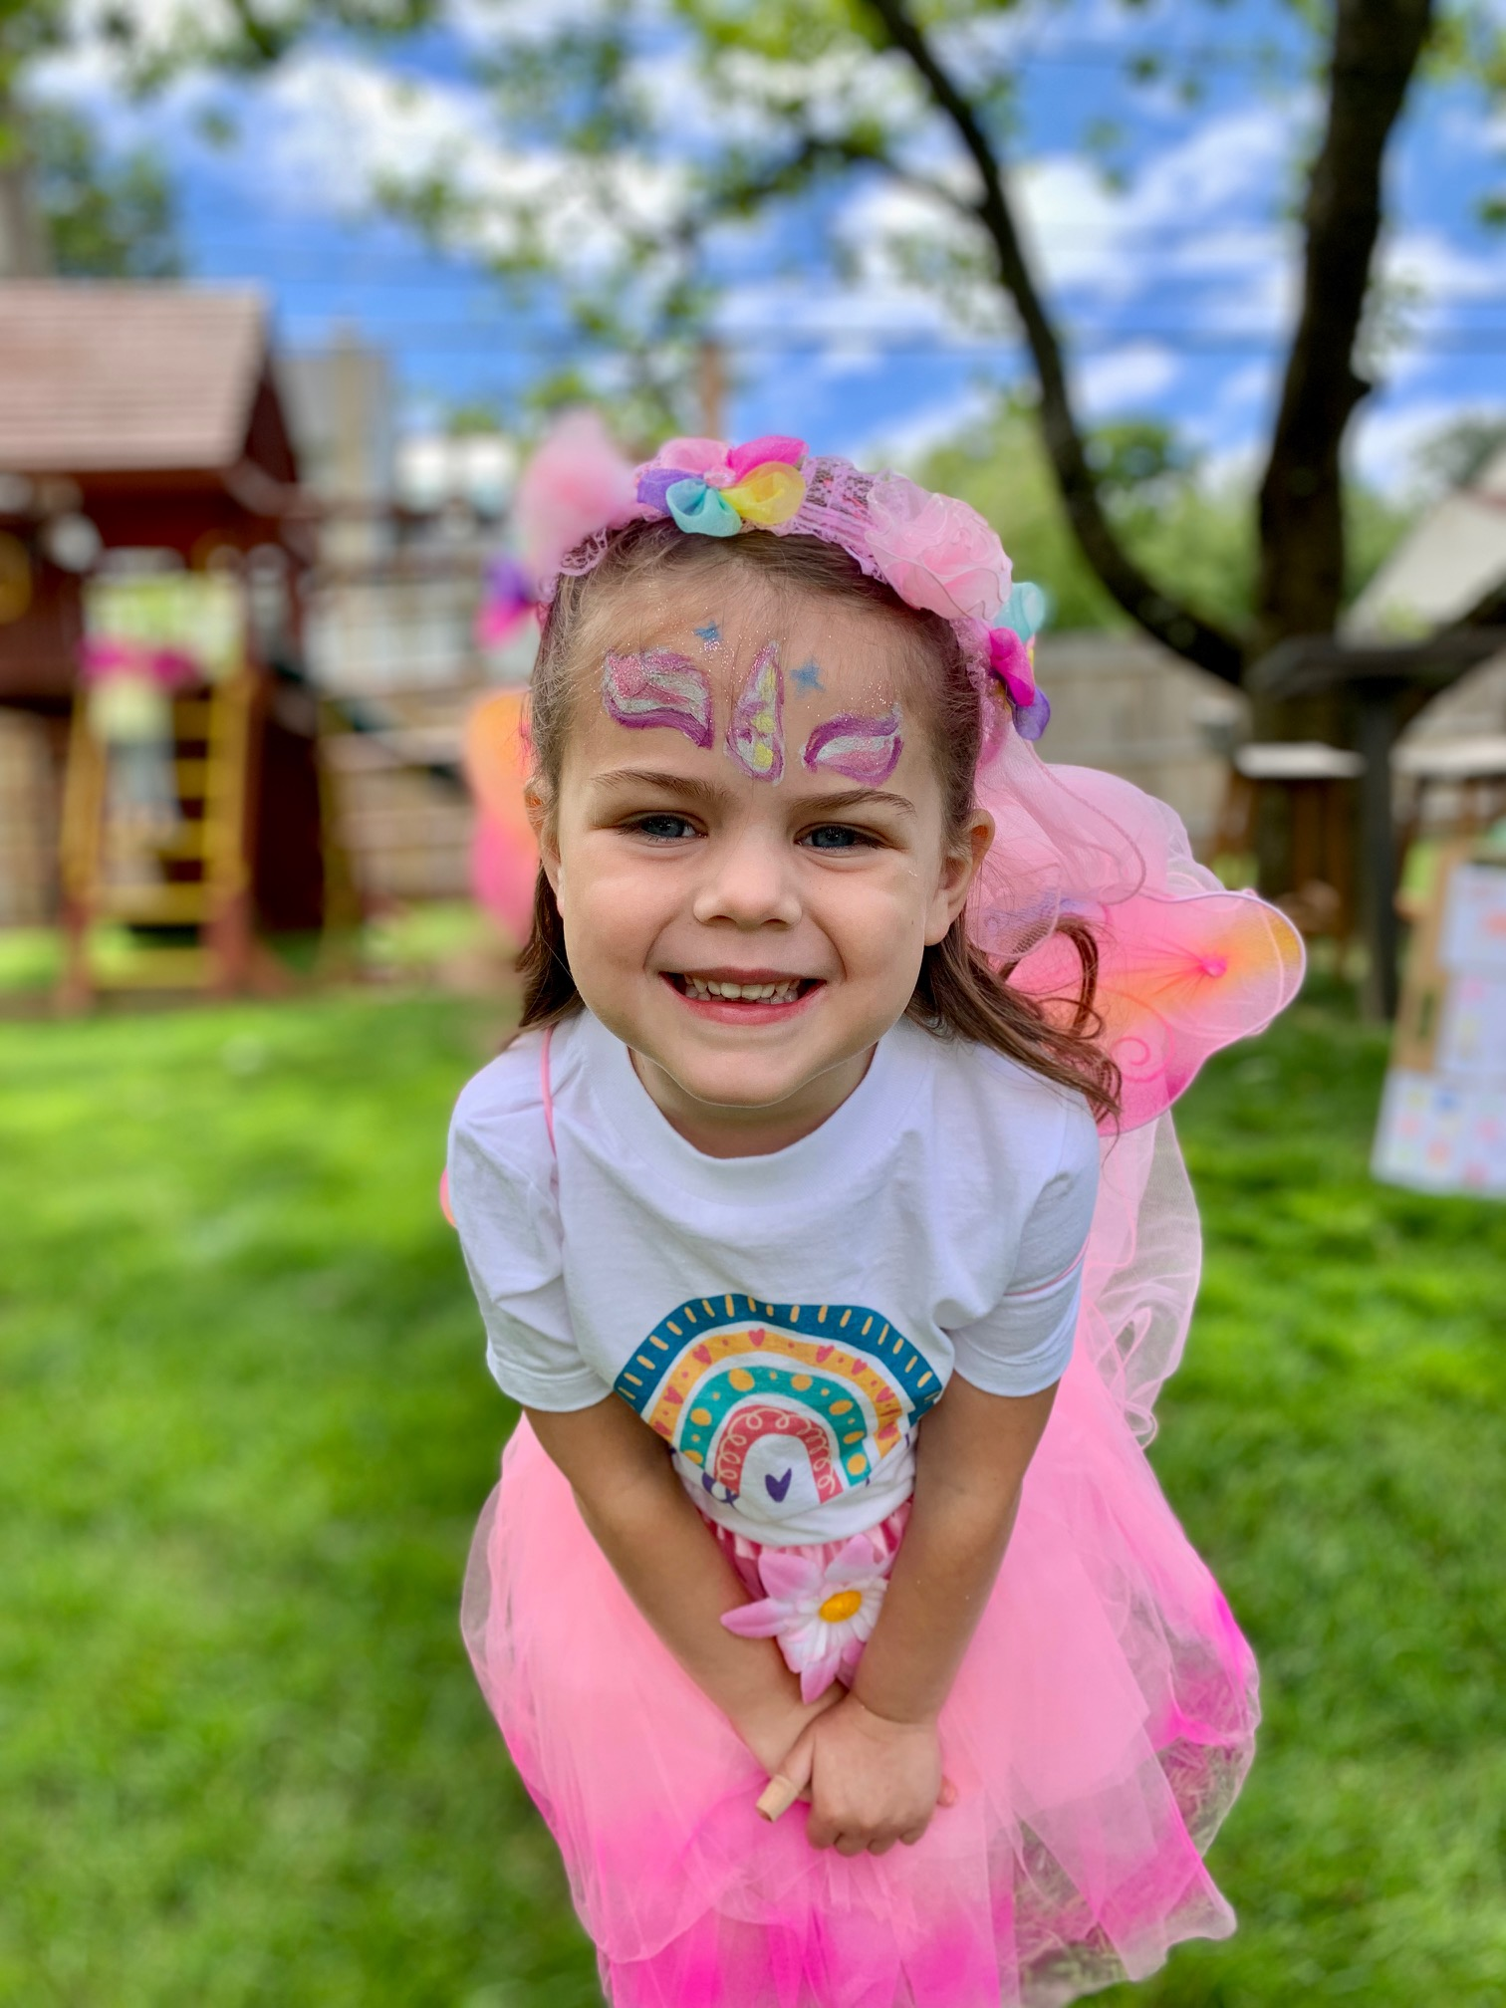
Terri Mehalick Conceptual, Academic, Honors, & AP Chemistry
Cabrini University M. Ed. (2016)
CB West High School
Fall ’14 – Present
CB East High School
Spring ’14 – Spring ’15
CB South High School
Fall ’12 – Spring ’14
Pennsylvania State University B.S. Secondary Education, Chemistry option (2012)

Slide 4
Course Outline by Unit (defined by the CollegeBoard)
Moles, Atomic Structure, & Periodicity
Bonding
Gases, Intermolecular Forces, & Solutions
*Spectroscopy
4. Chemical Reactions & Stoichiometry
Kinetics
Thermochemistry
Equilibrium
Acid/Base Equilibria
Thermodynamics & Electrochemistry
the equivalent of two college courses – general chemistry class & lab – administered in the 30ish weeks prior to the AP Exam early May
many universities accept passing AP scores (3, 4, 5) & award two classes worth of credit (which could amount to 8 credits or ~$8,000 in savings)

Slide 5
Course Outline by Unit (defined by the CollegeBoard)
Moles, Atomic Structure, & Periodicity
Bonding
Gases, Intermolecular Forces, & Solutions
*Spectroscopy
4. Chemical Reactions & Stoichiometry
Kinetics
Thermochemistry
Equilibrium
Acid/Base Equilibria
Thermodynamics & Electrochemistry
1 test per unit Unit 1 Exam 9/23
Format of exams mirrors that of the AP Test: MC & FRQs

Slide 6
Grades
2nd MP
40%

Slide 7
Our Main Technology Platforms
CANVAS
ONENOTE

Slide 8
Our Main Technology Platforms
CANVAS Interacting with daily “Do Now,” Agenda, Objectives, & Homework Submitting assignments (labs, Phases, etc.) Taking practice quizzes Accessing relevant answer keys to OneNote worksheets *Organized by Unit*
ONENOTE

Slide 9
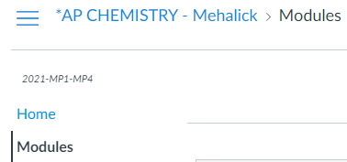
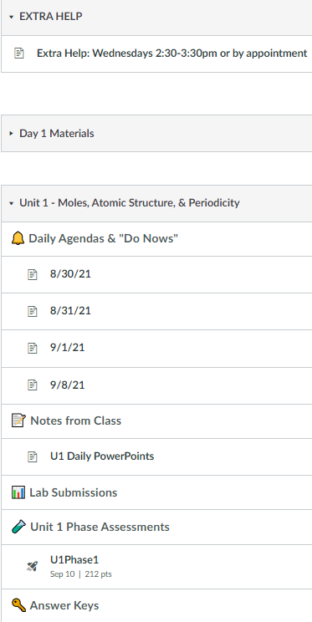
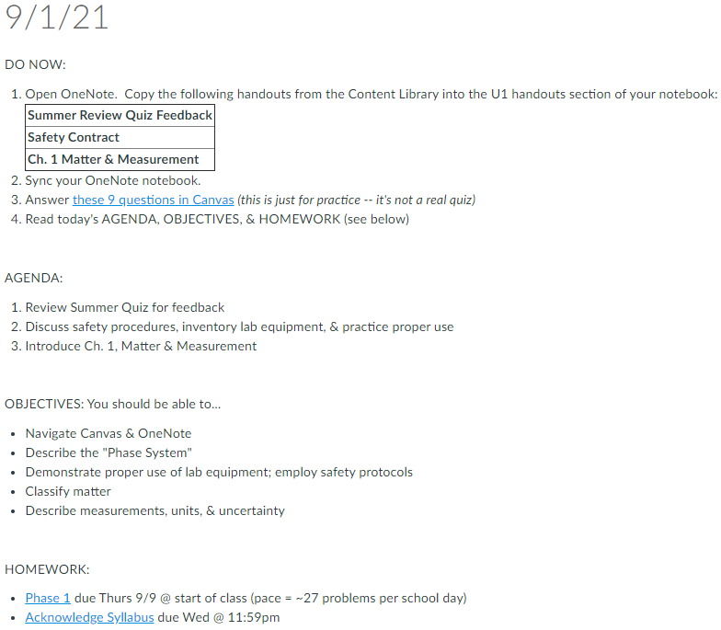
Our Main Technology Platforms
CANVAS Interacting with daily “Do Now,” Agenda, Objectives, & Homework Submitting assignments (labs, Phases, etc.) Taking practice quizzes Accessing relevant answer keys to OneNote worksheets *Organized by Unit*

Slide 10
Our Main Technology Platforms
CANVAS Interacting with daily “Do Now,” Agenda, Objectives, & Homework Submitting assignments (labs, Phases, etc.) Taking practice quizzes Accessing relevant answer keys to OneNote worksheets *Organized by Unit*
ONENOTE Viewing handouts Taking notes Recording work for labs & homework *Organized by Unit*

Slide 11
Our Main Technology Platforms
CANVAS Interacting with daily “Do Now,” Agenda, Objectives, & Homework Submitting assignments (labs, Phases, etc.) Taking practice quizzes Accessing relevant answer keys to OneNote worksheets *Organized by Unit*
ONENOTE Viewing handouts Taking notes Recording work for labs & homework *Organized by Unit*
Students are always welcome to write on paper/pencil & upload images of work as needed

Slide 12
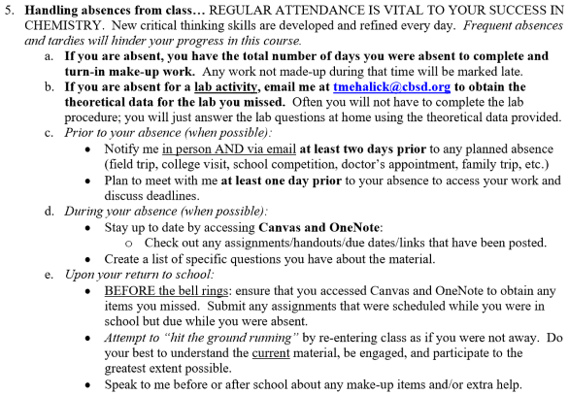
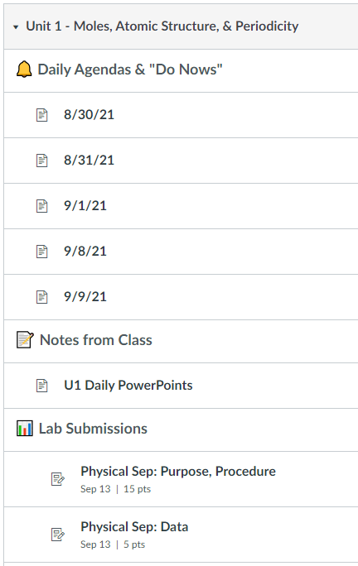
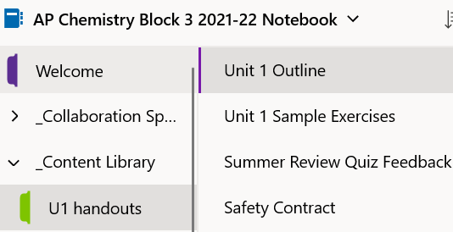
Absence Resources

Slide 13
Unit “Phases” Overview
GOAL: To ensure visibility & accountability by providing nongraded feedback at strategic checkpoints throughout a unit.
Phase 1: Basic Skills (first few days of unit)
Preview core concepts of a unit by solving problems (solutions provided)
Phase 2: Application (middle chunk of unit)
Traditional lessons, but focused due to feedback from Phase 1
Includes test-like checkpoint quiz for additional nongraded input
Phases 3–4: Practice Tests (days leading up to unit exam)
Take-home MCQs & test-like scenario FRQ to kickstart review

Slide 14
Recommendations from Former Students

Slide 15
Recommendations from Former Students (cont.)

